Slide 1
DNR Club Level TD Course
Morning Session
Movements & Scoring

Slide 2
Scope
Understanding of Basic Pairs Movements
2 Session Pairs
Basic Teams Movements
Manual Scoring
Bridgemates, EBUScore & Scorebridge
Qs & As
Laws, Regulations & Etiquette

Slide 3
Movements - History
John T. Mitchell 1854-1914. Scot who emigrated to USA. Bank Clerk. Father of Duplicate Whist. Movement published in 1891.
Edwin C. Howell 1860-1907. Born in Nantucket. Mathematician, Chess Player & Journalist. Expert Whist Player. Movement published in 1897.
Contract Bridge evolved from Duplicate Whist via Auction Bridge in 1925.

Slide 4
What is a Movement?
In Duplicate Bridge (or Duplicate Whist) it is the scheme which determines which competitors play which opponents; in what order and using which boards.
Competitors are identified using numbers +/- their pole positions (N/S or E/W).
Boards are numbered and organized into sets, generally of 2, 3 or 4 boards. The board sets are identified by letters e.g.
Set A = Boards 1-3, Set B = Boards 4-6 etc.

Slide 5
There are a lot of movements!

Slide 6
But you only need two!!

Slide 7
Requirements - Absolute
There is one and only one absolute requirement which is that: ”No Pair can Ever play the same board set twice”

Slide 8
Requirements - Desirable
No Pair should meet the same pair twice (No Revenge Rounds)
Every Pair should encounter every other pair
Every Pair should play every board set
Every board should be played the same number of times
The Movement should be Intrinsically Fair (Balanced)
The Movement should be complete
Board Sharing holds thing up, especially using 2-board sets

Slide 9
Requirements Critical in the Real World
You must choose a movement which allows the club to play the number of boards it desires
Too few and the fanatics will complain
Too many and the social players will complain
You must choose a movement which has sufficient seated positions to accommodate the needs of members with mobility issues
If the club requires a single winner competition, this impinges on your choice of movements

Slide 10
Round 1
NS1vEW1
BS-A
NS2vEW2
BS-B
NS3vEW3
BS-C
NS4vEW4
BS-D
NS5vEW5
BS-E

Slide 11
Round 2
NS1vEW5
BS-B
NS2vEW1
BS-C
NS3vEW2
BS-D
NS4vEW3
BS-E
NS5vEW4
BS-A

Slide 12
Round 3
NS1vEW4
BS-C
NS2vEW5
BS-D
NS3vEW1
BS-E
NS4vEW2
BS-A
NS5vEW3
BS-B

Slide 13
Round 4
NS1vEW3
BS-D
NS2vEW4
BS-E
NS3vEW5
BS-A
NS4vEW1
BS-B
NS5vEW2
BS-C

Slide 14
Round 5
NS1vEW2
BS-E
NS2vEW3
BS-A
NS3vEW4
BS-B
NS4vEW5
BS-C
NS5vEW1
BS-D

Slide 15
Analysis – Very Good!
It passes the Absolute test
There’s no “Revenge Round”
Assuming the movement is complete, Everyone plays all the boards
All boards are played by the same number of pairs
If you are happy with two winners, everyone plays everyone else
Within Each Pole, it’s perfectly balanced
Plays 20 or 25 boards with plenty of stationary pairs & no Sharing

Slide 16
Round 1
NS1vEW1 BS-A
NS2vEW2
BS-B
NS3vEW3
BS-C
NS4vEW4
BS-D
NS5vEW5
BS-E
NS6vES6
BS-F

Slide 17
Round 2
NS1vEW6 BS-B
NS2vEW1
BS-C
NS3vEW2
BS-D
NS4vEW3
BS-E
NS5vEW4
BS-F
NS6vES5
BS-A

Slide 18
Round 3
NS1vEW5 BS-C
NS2vEW6
BS-D
NS3vEW1
BS-E
NS4vEW2
BS-F
NS5vEW3
BS-A
NS6vES4
BS-B

Slide 19
Round 4
NS1vEW4 BS-D
NS2vEW5
BS-E
NS3vEW6
BS-F
NS4vEW1
BS-A
NS5vEW2
BS-B
NS6vES3
BS-C

Slide 20
OOPS!!!
In Round 4, E/W 1 encounter board set A which they have already played in Round 1 violating the Absolute Requirement
Solution 1 – Skip after 3 rounds
Easy (once you don’t forget to skip)
You play one round fewer than there are tables so movement incomplete OR
You “play the skip”, introducing a “Revenge Round”
Solution 2 – When you put out the boards, put Set-D on a chair between tables 3 & 4, E on Table 4 and F on Table 5. Tables 1 & 6 Share
It’s not as good as the Straight Mitchell but it’s still pretty good

Slide 21
Half Tables Phantom Pairs 👻 & Mythical Shares 🦄
Play the movement as usual, pretend that the missing pair exist as a “phantom pair”.
When you land at a table where you should be playing the phantom pair, you sit out.
In general, the phantom pair is best seated as NS at the highest number table so the first sit-out has the EW pair at that table.
In some movements, the above arrangement is mandatory.
Play a share & relay as the share becomes “mythical”.
Avoid a skip as the pair sitting out during the first round may have to sit out again during their last round.

Slide 22
One Winner (Scrambled Mitchell)
It is possible to have a one winner Mitchell Movement.
Arrow Switch one round for competitions with 8 or fewer tables and two rounds if there are more than 8 tables.
Seeding becomes more important.
You must assign each pair a unique number. N/S players use their table numbers. EW players are assigned a number equal to their starting table number plus n; where n=the total number of tables or n= a multiple of 10 where that multiple > the number of tables.

Slide 23
Appendices & Hesitations
Used to deal with awkward numbers
There are many variations but two will be illustrated
You have 7 tables and want to run a Mitchell but your club members always expect to play 24 boards. A Standard Mitchell yields either 21 or 28 boards – no one will be happy
SOLUTION – A 7 table Hesitation Mitchell
Same club but this time 9 ½ tables show up. You could run a Share & Relay Mitchell curtailed to 8 rounds but that’s horrible!
SOLUTION – A 1 ½ Table Appendix Mitchell (aka Bowman)

Slide 24
7 Table Hesitation Mitchell
Look at it from E/W’s perspective:
T1 -> T2 -> T3 -> T4 -> T5 -> T6 -> T7 -> T7 as N/S
So you play 8 rounds x 3 boards/round = 24
Relay between Tables 3 & 4
Arrow Switch Last Round (except T7)
One Winner

Slide 25
1 ½ Appendix Mitchell (24 boards, 9 ½ tables)

Slide 26
Howell Movements (Full)
You designate a “Pivot Pair”. They sit N/S at the highest numbered table. Say there are 10 pairs. The pivot pair sit throughout and every other pair come and play against them. That requires 9 rounds.
The movement is designed so every pair plays every other.
It’s well balanced and produces one winner.
The movement is awkward and there are several variants.
There’s only 1 sitting pair.
The number of rounds = 2T-1, so 9 here, so 18 or 27 boards.

Slide 27
Reduced Howell Movement (Three Quarter)
You can introduce one or more extra sitting pairs by converting a moving pair to a sitting pair
For every sitting pair you introduce, you drop a round so;
8 Table Full Howell has 15 rounds, 1 sitting position, 15 or 30 boards
8 Table ¾ Howell has 14 rounds, 2 sitting positions, 14 or 28 boards or 13R, 3SP, 26B or 12R, 4SP, 24B …………..8R, 8SP, 24B (AKA??)
The more extra sitting positions, the more unbalanced it becomes
The notion that Howells are “superior” to Mitchells is a gross over-simplification. ¾ Howells can be Very Unfair and Deceptive

Slide 28
2 Section & 2 Session Pairs Competitions
2 Sections – With Duplicated Boards you can merge the sections
2 Sessions
Typically run a Mitchell in the first session (Omit round one if an odd number of tables)
In second session, the NS compete among themselves in a Howell, ditto the EWs, so you run two Howells
In practice, there are movements available to achieve this using one set of boards. For even number of tables, they tend to be called Dual Howells. For odd number of tables, they are often called Jannersten Interwoven Howells

Slide 29
Teams and Individual Movements
Mirrored Movements
Swiss Teams
American Whist (Odd number of teams)
New England Relay (Even)
Thurner (6, 8, 12, 14)
Rainbow Individual Movements (Prime)

Slide 30
End of Movements Section
Any Questions?

Slide 31
Scoring a Pairs Competition
Put the scoresheets in order and make sure you have them all.
Count the number of times each Board was played as this will determine the TOP score.
Remember all scoring is done from North/Souths perspective and in manual scoring we will award a TOP to the highest N/S score and that becomes a BOTTOM for the East/West Pair. Therefore if the TOP of 24 is awarded to number 7 N/S it follows that the E/W against whom they were playing will get 0.
How to calculate the TOP
If Board is Played 13 Times the top is 24 (13-1)X2
If played 9 times the top is 16 (9-1)x2
13 Times | 12 Times | 11 Times | 10 Times | 9 Times | 8 Times | 7 Times | 6 Times | 5 Times
24 | 22 | 20 | 18 | 16 | 14 | 12 | 10 | 8
22 | 20 | 18 | 16 | 14 | 12 | 10 | 8 | 6
20 | 18 | 16 | 14 | 12 | 10 | 8 | 6 | 4
18 | 16 | 14 | 12 | 10 | 8 | 6 | 4 | 2
16 | 14 | 12 | 10 | 8 | 6 | 4 | 2 | 0
14 | 12 | 10 | 8 | 6 | 4 | 2 | 0
12 | 10 | 8 | 6 | 4 | 2 | 0
10 | 8 | 6 | 4 | 2 | 0
8 | 6 | 4 | 2 | 0
6 | 4 | 2 | 0
4 | 2 | 0
2 | 0
0
156 | 132 | 110 | 90 | 72 | 56 | 42 | 30 | 20

Slide 32
N/S | E/W | Contract | By | N/S | E/W | Match | Points
1 | 13 | 3H+1 | N | 170 |  | 4
2 | 15 | 4H | N | 620 |  | 12
3 | 17 | 4H+1 | N | 650 |  | 19
4 | 19 | 4H-1 | N |  | 100 | 2
5 | 21 | 3NT+2 | S | 660 |  | 22
6 | 23 | 3NT+1 | S | 630 |  | 16
7 | 14 | 3S | E |  | 140 | 0
8 | 16 | 2NT+2 | S | 180 |  | 6
9 | 18 | 5D*-3 | W | 500 |  | 8
10 | 20 | 4H | N | 620 |  | 12
11 | 22 | 4H | N | 620 |  | 12
12 | 24 | 4H+1 | N | 650 |  | 19
 |  |  |  |  |  | 132
Because this board was played 12 times the top is 22 (12-1)x2
You start off with the highest N/S score , in this case 660 so pair 5 get 22.
The next highest is 650 but there are 2 of them so they share the 20 and 18 which gives them 19 each.
Next comes 630 so pair 6 gets 16.
Now we have 3 pairs scoring 620 so they must share 14,12 an 10 (36/3) giving them 12 each.
Pair 9 who scored 500 are next so they get 8.
Now pair 8 got 180 so they get 6.
Pair 1 got 170 so they get 4.
Now we come to the minus scores where the lowest minus is the best so
Pair 4 who scored -100 get 2.
Pair 7 who scored -140 get the Zero.
Total the points and they should come to 132 which is the number of times played multiplied by number of times played minus 1 (12X11)

Slide 33
If you are scoring a Mitchell Movement you don’t need to bother calculating the East/West scores because you will use 2 Recap sheets and will award the prizes to the highest N/S and to the lowest E/W.
When scoring a Howell movement you will use only one Recap Sheet so you must enter the East/West score on the traveller otherwise you will have difficulty completing the recap sheet.
You calculate the East/West score by deducting the North/South score from the TOP( In this case 22)
You will notice that what is a TOP for N/S is a bottom for E/W and vice versa.
N/S | E/W | Contract | By | N/S | E/W | Match | Points
1 | 13 | 3H+1 | N | 170 |  | 4 | 18
2 | 15 | 4H | N | 620 |  | 12 | 10
3 | 17 | 4H+1 | N | 650 |  | 19 | 3
4 | 19 | 4H-1 | N |  | 100 | 2 | 20
5 | 21 | 3NT+2 | S | 660 |  | 22 | 0
6 | 23 | 3NT+1 | S | 630 |  | 16 | 6
7 | 14 | 3S | E |  | 140 | 0 | 22
8 | 16 | 2NT+2 | S | 180 |  | 6 | 16
9 | 18 | 5D*-3 | W | 500 |  | 8 | 14
10 | 20 | 4H | N | 620 |  | 12 | 10
11 | 22 | 4H | N | 620 |  | 12 | 10
12 | 24 | 4H+1 | N | 650 |  | 19 | 3
 |  |  |  |  |  | 132 | 132

Slide 34
N/S | E/W | Contract | By | N/S | E/W | Match | Points
1 | 1 | 1NT | W |  | 90
2 | 3 | 1NT-1 | W | 50
3 | 5 | 2H-1 | W | 50
4 | 7 | 2H | W |  | 110
5 | 9 | 2S | S | 110
6 | 11 | 1NT | S | 90
7 | 2 | 2H-1 | W | 50
8 | 4 | 3S | S | 140
9 | 6 | 3S | S | 140
10 | 8 | 2S | S | 110
11 | 10 | 2H-1 | W | 50

Slide 35
N/S | E/W | Contract | By | N/S | E/W | Match | Points
1 | 1 | 1NT | W |  | 90 | 2
2 | 3 | 1NT-1 | W | 50 |  | 7
3 | 5 | 2H-1 | W | 50 |  | 7
4 | 7 | 2H | W |  | 110 | 0
5 | 9 | 2S | S | 110 |  | 15
6 | 11 | 1NT | S | 90 |  | 12
7 | 2 | 2H-1 | W | 50 |  | 7
8 | 4 | 3S | S | 140 |  | 19
9 | 6 | 3S | S | 140 |  | 19
10 | 8 | 2S | S | 110 |  | 15
11 | 10 | 2H-1 | W | 50 |  | 7
 |  |  |  |  |  | 110

Slide 36
N/S | E/W | Contract | By | N/S | E/W | Match N/S | Points E/W
1 | 1 | 3C-2 | S |  | 200
2 | 3 | 5C*-3 | S |  | 800
3 | 5 | 3C-1 | S |  | 100
4 | 7 | 3C-1 | S |  | 100
5 | 9 | 3C-1 | S |  | 100
6 | 11 | 3C*+1 | E |  | 870
7 | 13 | 2S | E |  | 110
8 | 2 | 3S | E |  | 140
9 | 4 | 3S | E |  | 140
10 | 6 | 3S | E |  | 140
11 | 8 | 3C-1 | S |  | 100
12 | 10 | 3S+1 | E |  | 170
13 | 12 | 3S+1 | E |  | 170

Slide 37
N/S | E/W | Contract | By | N/S | E/W | Match | Points
1 | 1 | 3C-2 | S |  | 200 | 4
2 | 3 | 5C*-3 | S |  | 800 | 2
3 | 5 | 3C-1 | S |  | 100 | 21
4 | 7 | 3C-1 | S |  | 100 | 21
5 | 9 | 3C-1 | S |  | 100 | 21
6 | 11 | 3C*+1 | S |  | 870 | 0
7 | 13 | 2S | E |  | 110 | 16
8 | 2 | 3S | E |  | 140 | 12
9 | 4 | 3S | E |  | 140 | 12
10 | 6 | 3S | E |  | 140 | 12
11 | 8 | 3C-1 | S |  | 100 | 21
12 | 10 | 3S+1 | E |  | 170 | 7
13 | 12 | 3S+1 | E |  | 170 | 7
 |  |  |  |  |  | 156

Slide 38
N/S | E/W | Contract | By | N/S | E/W | Match | Points
1 | 1 | 2S | N | 110
2 | 3 | 2S | N | 110
3 | 5 | 2S | N | 110
4 | 7 | Passed | Out
5 | 9 | 2S+2 | N | 170
6 | 11 | 2S | N | 110
7 | 2 | 2H-3 | N |  | 150
8 | 4 | 2H | N | 110
9 | 6 | 2H+1 | N |  | 50
10 | 8 | 3D | E |  | 110
11 | 10 | 2S | N | 110

Slide 39
N/S | E/W | Contract | By | N/S | E/W | Match | Points
1 | 1 | 2S | N | 110 |  | 13
2 | 3 | 2S | N | 110 |  | 13
3 | 5 | 2S | N | 110 |  | 13
4 | 7 | Passed | Out |  |  | 6
5 | 9 | 2S+2 | N | 170 |  | 20
6 | 11 | 2S | N | 110 |  | 13
7 | 2 | 2H-3 | N |  | 150 | 0
8 | 4 | 2H | N | 110 |  | 13
9 | 6 | 2H+1 | N |  | 50 | 4
10 | 8 | 3D | E |  | 110 | 2
11 | 10 | 2S | N | 110 |  | 13
 |  |  |  |  |  | 110

Slide 40
N/S | E/W | Contract | By | N/S + | E/W - | Match | Points
1 | 1 | 4H – 2 | W | 100
2 | 3 | 2H + 1 | W |  | 140
3 | 5 | Average
4 | 7 | 4S - 2 | S |  | 100
5 | 9 | 2H + 1 | W |  | 140
6 | 11 | 2H + 1 | W |  | 140
7 | 13 | 2H + 1 | W |  | 140
8 | 2 | 3H | W |  | 140
9 | 4 | 3H + 1 | W |  | 170
10 | 6 | 3S | S | 140
11 | 8 | 2H | W |  | 110
12 | 10 | 3S | S | 140
13 | 12 | 2H | W |  | 110
 |  |  |  |  |  | 156

Slide 41
N/S | E/W | Contract | By | N/S + | E/W - | Match | Points
1 | 1 | 4H – 2 | W | 100 |  | 19
2 | 3 | 2H + 1 | W |  | 140 | 7
3 | 5 | Average |  |  |  | 12
4 | 7 | 4S - 2 | S |  | 100 | 17
5 | 9 | 2H + 1 | W |  | 140 | 7
6 | 11 | 2H + 1 | W |  | 140 | 7
7 | 13 | 2H + 1 | W |  | 140 | 7
8 | 2 | 3H | W |  | 140 | 7
9 | 4 | 3H + 1 | W |  | 170 | 1
10 | 6 | 3S | S | 140 |  | 22
11 | 8 | 2H | W |  | 110 | 14
12 | 10 | 3S | S | 140 |  | 22
13 | 12 | 2H | W |  | 110 | 14
 |  |  |  |  |  | 156

Slide 42
Team Scoring
The system of scoring most commonly used in Ireland is The International Match Points System usually referred to as IMPS.
To score using the IMPS table you must first ascertain the difference (if any) between the two scores for each board. The team which scored higher is awarded the appropriate number of IMPS (Plus score) according to the table. Obviously the other team gets a minus score. When all the matches have been played the IMPS are totalled and the difference is the margin by which one team beats another.
These IMPS are then converted to Victory Points to determine the result of the match. The conversion rate depends on the number of boards played in the Match. In Club team competitions there are likely to be 3 or 4 Board Matches but in League Matches there will be many boards – 20 or 24 would be

Slide 43
Team Scoring
The system of scoring most commonly used in Ireland is The International Match Points System usually referred to as IMPS.
To score using the IMPS table you must first ascertain the difference (if any) between the two scores for each board. The team which scored higher is awarded the appropriate number of IMPS (Plus score) according to the table. Obviously the other team gets a minus score. When all the matches have been played the IMPS are totalled and the difference is the margin by which one team beats another.
These IMPS are then converted to Victory Points to determine the result of the match. The conversion rate depends on the number of boards played in the Match. In Club team competitions there are likely to be 3 or 4 Board Matches but in League Matches there will be many boards – 20 or 24 would not be uncommon.

Slide 44
Make sure you have the corresponding sheets from the 2 teams involved.
If scores are in the same column on both sheets subtract one from the other.
Convert the difference using the International Match Point (IMP) Scale.
If both scores are in the N/S column give the plus to the sheet with the higher score.
If both score are in the E/W column give the plus to the sheet with the lower score.

Slide 45
Team Scoring (cont.)
If scores are in opposite columns add them together.
Convert the total using the IMP Scale.(Page 36 in the Diary).
Give the plus to the sheet that has the score in the N/S column.
Total the IMPs
Convert the IMP total using the Victory Point ( VP) conversion scale. (Page 37 in the Diary).
The column you use depends on the number of boards in the Match.

Slide 46
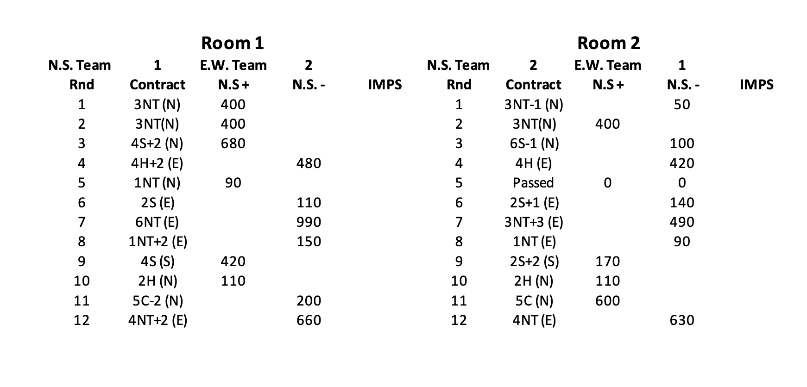

Slide 47
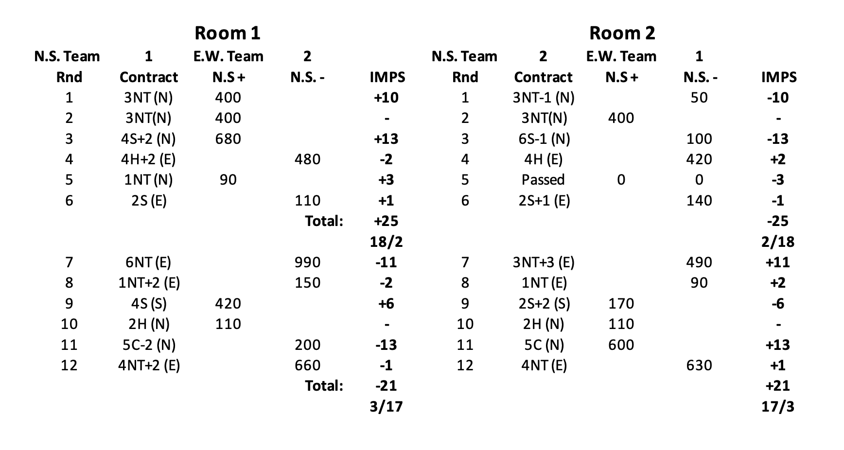

Slide 48
NORTH - SOUTH SCORE |  |  |  |  | NORTH - SOUTH SCORE
N.S. Team | 1 | E.W. Team | 2 |  | N.S. Team | 1 | E.W. Team | 2
Rnd | Contract | N.S + | N.S. - | IMPS | Rnd | Contract | N.S + | N.S. - | IMPS
1 | 3NT (N) | 400 |  |  | 1 | 3NT-1 (N) |  | 50
2 | 3NT(N) | 400 |  |  | 2 | 3NT(N) | 400
3 | 4S+2 (N) | 680 |  |  | 3 | 6S-1 (N) |  | 100
4 | 4H+2 (E) |  | 480 |  | 4 | 4H (E) |  | 420
5 | 1NT (N) | 90 |  |  | 5 | Passed | 0 | 0
6 | 2S (E) |  | 110 |  | 6 | 2S+1 (E) |  | 140
7 | 6NT (E) |  | 990 |  | 7 | 3NT+3 (E) |  | 490
8 | 1NT+2 (E) |  | 150 |  | 8 | 1NT (E) |  | 90
9 | 4S (S) | 420 |  |  | 9 | 2S+2 (S) | 170
10 | 2H (N) | 110 |  |  | 10 | 2H (N) | 110
11 | 5C-2 (N) |  | 200 |  | 11 | 5C (N) | 600
12 | 4NT+2 (E) |  | 660 |  | 12 | 4NT (E) |  | 630

Slide 49
NORTH - SOUTH SCORE |  |  |  |  | NORTH - SOUTH SCORE
N.S. Team | 1 | E.W. Team | 2 |  | N.S. Team | 1 | E.W. Team | 2
Rnd | Contract | N.S + | N.S. - | IMPS | Rnd | Contract | N.S + | N.S. - | IMPS
1 | 3NT (N) | 400 |  | +10 | 1 | 3NT-1 (N) |  | 50 | -10
2 | 3NT(N) | 400 |  | - | 2 | 3NT(N) | 400 |  | -
3 | 4S+2 (N) | 680 |  | +13 | 3 | 6S-1 (N) |  | 100 | -13
4 | 4H+2 (E) |  | 480 | -2 | 4 | 4H (E) |  | 420 | +2
5 | 1NT (N) | 90 |  | +3 | 5 | Passed | 0 | 0 | -3
6 | 2S (E) |  | 110 | +1 | 6 | 2S+1 (E) |  | 140 | -1
 |  |  | Total: | +25 |  |  |  |  | -25
 |  |  |  | 18/2 |  |  |  |  | 2/18
7 | 6NT (E) |  | 990 | -11 | 7 | 3NT+3 (E) |  | 490 | +11
8 | 1NT+2 (E) |  | 150 | -2 | 8 | 1NT (E) |  | 90 | +2
9 | 4S (S) | 420 |  | +6 | 9 | 2S+2 (S) | 170 |  | -6
10 | 2H (N) | 110 |  | - | 10 | 2H (N) | 110 |  | -
11 | 5C-2 (N) |  | 200 | -13 | 11 | 5C (N) | 600 |  | +13
12 | 4NT+2 (E) |  | 660 | -1 | 12 | 4NT (E) |  | 630 | +1
 |  |  |  | -21 |  |  |  |  | +21
 |  |  |  | 3/17 |  |  |  |  | 17/3

Slide 51
When you have totalled both sheets the totals should of course match.
For example
if 1 playing 2 shows +17
then 2 playing 1 should show -17
Now go to Victory Point scale (page 37 in the Diary)
We are talking about 6 board matches here so go across the top to 6 Boards and come down that line to 17. (In this case 14-17)
Now go left along that line to get the result 16/4.
Obviously the team with the + score gets the 16.

Slide 52
Which sheet gets the Plus?
If both scores are in the N/S column
Subtract one from the other
Convert using table
Put the Plus on the sheet with the higher score
If both scores are in the E/W column
Subtract one from the other
Convert using table
Put the Plus on the sheet with the lower score
If the scores are in opposite columns
Add one to the other
Convert using table
Put the Plus on the sheet that has the N/S score

Slide 53
Manual Scoring
Any Questions?

Slide 54
Manual Scoring
Board 3 - E/W Vul
N/S | E/W | Contract | By | N/S | E/W | N/S rank | MPs
1 | 7 | 3NT | N | 400 |  | 2 | 10
2 | 2 | 2H+1 | S | 140 |  | 4 | 6
3 | 4 | 3NT-1 | S |  | 50 | =5 | 3
4 | 6 | 4H-1 | N |  | 50 | =5 | 3
5 | 1 | 3D | E |  | 110 | 7 | 0
6 | 3 | 3NT+1 | N | 430 |  | 1 | 12
7 | 5 | 2H+2 | N | 170 |  | 3 | 8
 |  |  |  |  |  | Check Sum | 42

Slide 55
With an Average
Board 3 - E/W Vul
N/S | E/W | Contract | By | N/S | E/W | N/S rank | MPs
1 | 7 | 3NT | N | 400 |  | 2 | 9
2 | 2 | 2H+1 | S | 140 |  | 3 | 7
3 | 4 | 3NT-1 | S |  | 50 | 5 | 5
4 | 6 | 4H-2 | N |  | 100 | 6 | 3
5 | 1 | 3D | E |  | 110 | 7 | 1
6 | 3 | 3NT+1 | N | 430 |  | 1 | 11
7 | 5 | Av/Av | N | 50% |  | Average | 6
 |  |  |  |  |  | Check Sum | 42

Slide 56
The Neuberg Formula
Match Points = ((M x E) + (E – A)) / A
M is match points considered in isolation
E is the Expected number of Scores
A is the Actual number of Scores

Slide 57
Computer Scoring
EBUScore or ScoreBridge
You can enter either the numeric score or the contract details in either.
I strongly recommend the latter because:
The system will generate the numeric score which can act as a cross-check.
Your results will include contract details.
If you are feeling energetic, you can also enter the opening lead.

Slide 58
Wireless Scoring - How it Works

Slide 59
SOP
Double Check you are Connected to the Mains
Launch Scoring Program
Create Event
Select Movement
Launch Bridgemate Control Software
Hopefully, forget about it until end

Slide 60
What can go Wrong?
You put in the Wrong Movement
Poor communication with TD
Forget it’s a Single Winner Mitchell
You put the movement in too early
Someone Arrives Late
What do you do to cure it
Delete the event
Re-enter
Create New Database
Players must re-enter their numbers and early scores

Slide 61
During Competition
Wrong Name or Name Omitted – Fix at any table OR record on paper
Wrong Score – Fix at table using TD menu OR record on paper
Simple error in score
Omitting Double
Playing in Wrong Order
Assigning Adjusted Scores, Pass Outs, Not Played – Bridgemate
Accidentally close Scoring Program or BCS
Hardware Problems

Slide 62
Hardware Problems
Individual Bridgemate Dies – Replace it with spare
Computer Dies but Bridgemates are working fine
Continue Game. Ensure Server is not turned off at end of session
Bridgemates Stop Working
Go to Paper. The competition up to point of failure should be ok

Slide 63
Change Table or Section (1 of 4)
Start the Bridgemate and press the “Setup” softkey.

Slide 64
Change Table or Section (2 of 4)
Enter the Setup PIN (749)

Slide 65
Change Table or Section (3 of 4)
Use Arrow Softkeys to navigate the menu and the + and – Hardkeys to change entries. When finished, press the “Back” softkey

Slide 66
Change Table or Section (4 of 4)
Back to homepage, ready to go.

Slide 67
Changing Names (1 of 3)
From Any Screen with a “Names” softkey – Press it

Slide 68
Changing Names (2 of 3)
The names of the people Currently sitting at the Table appear. Press the “Correc” softkey

Slide 69
Changing Names (3 of 3)
The Player Number Entry Screen Re- Appears. Enter the correct numbers.

Slide 70
Erasing an Erroneous Entry (1 of 4)
Press the “TDMENU” softkey

Slide 71
Erasing an Erroneous Entry (2 of 4)
Enter the TD PIN (****)

Slide 72
Erasing an Erroneous Entry (3 of 4)
Select Option 3

Slide 73
Erasing an Erroneous Entry (4 of 4)
Enter the number of the board you want to erase. Press OK. You will get a brief “Board Erased” message and will be brought back to the TD Menu. Press the back softkey.

Slide 74
Assigning an Average (1 of 5)
Make sure the cursor is blinking beside CONTR. THIS IS CRITICAL.
Now press the “TDMENU” softkey and enter the TD PIN.

Slide 75
Assigning an Average (2 of 5)
Select Item 1. Adjusted Score

Slide 76
Assigning an Average (3 of 5)
For an Average, enter 5 for NS
For Average +, enter 6
For Average -, enter 4
Repeat for EW

Slide 77
Assigning an Average (4 of 5)
E.G. Press 5 5, then Press OK

Slide 78
Assigning an Average (5 of 5)
The average is assigned and EW accept in the usual way

Slide 79
Misboarding (1 of 2)
Go to the TD Menu and select Item 7 “HAND RECORDS”. Select 1 to view hand records. You will be asked for the board number.

Slide 80
Misboarding (2 of 2)
The hand record is displayed. Don’t attempt this unless you have permission to do so. You also need good eyesight!

